Slide 1


PARCEL TRACKING SYSTEM

Slide 2

OUR TEAM
ABHISHE CHAUHAN - 23CP028
YUG PATEL - 23CP039
ES105 - PPS
VIRAL BHOI - 23CP029
PROFF. MAYUR VEGAD

Slide 3

WHAT TO EXPECT
getting information from customer id
01
02
adding user
Diplay information from added uder
03

Slide 4
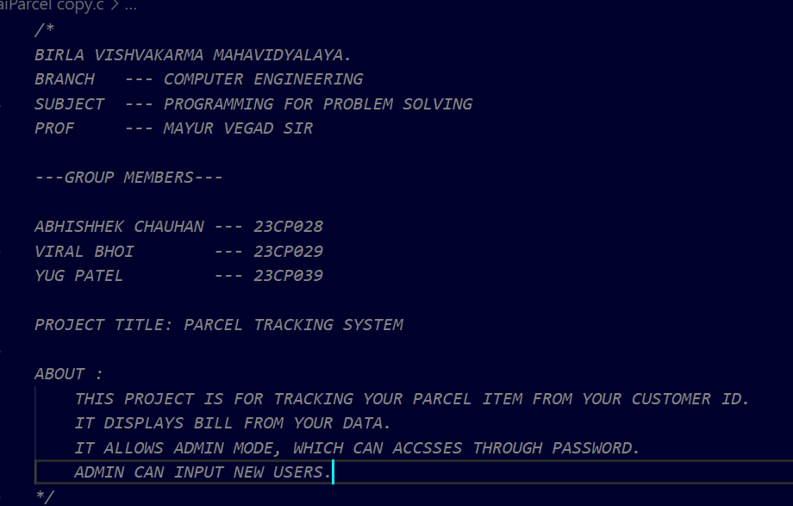
DOCUMENTATION

Slide 5
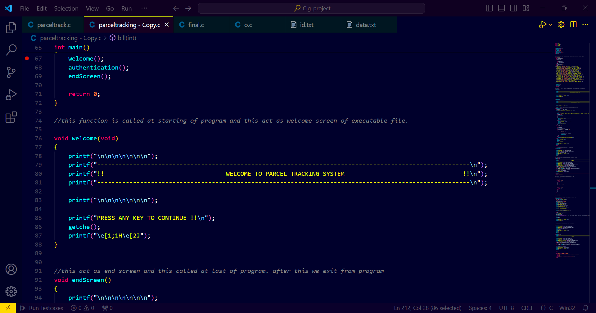
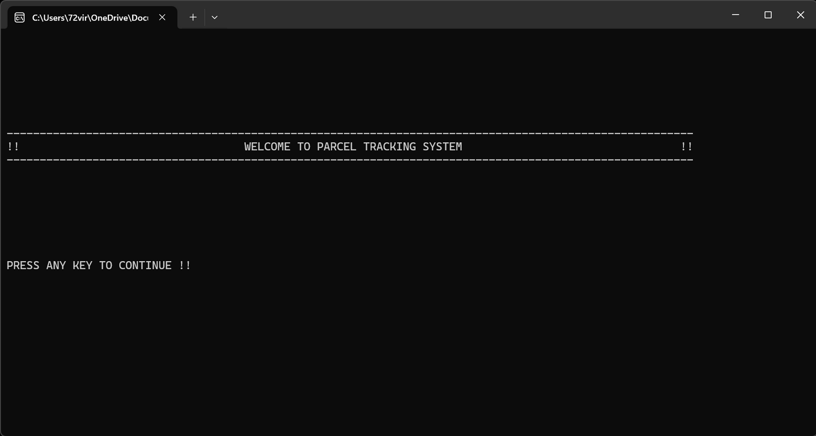
WELCOME SCREEN

Slide 6
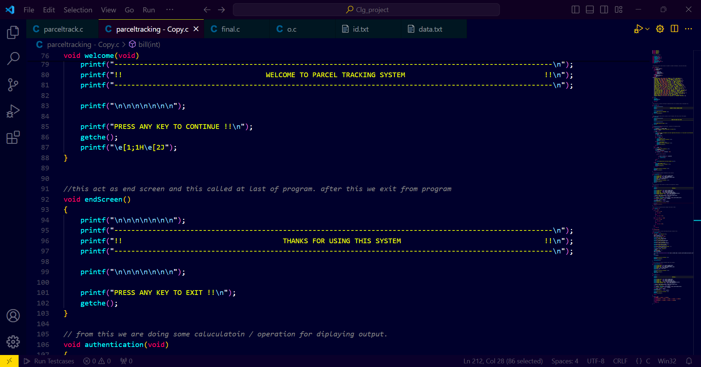
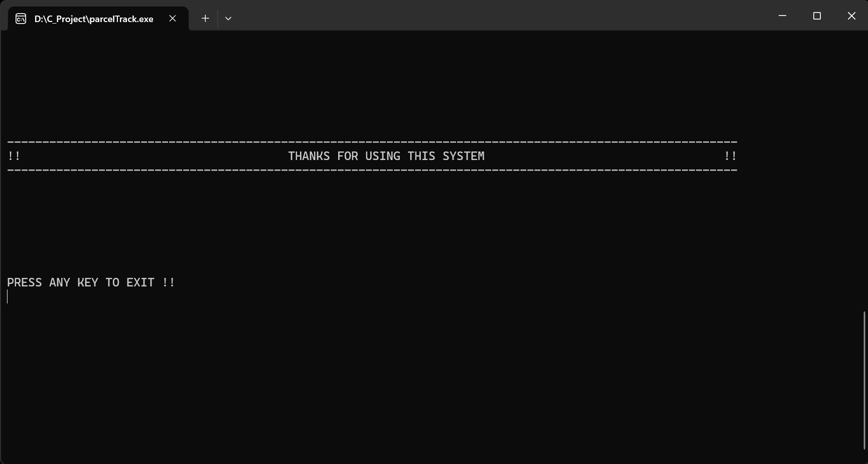
END SCREEN

Slide 7
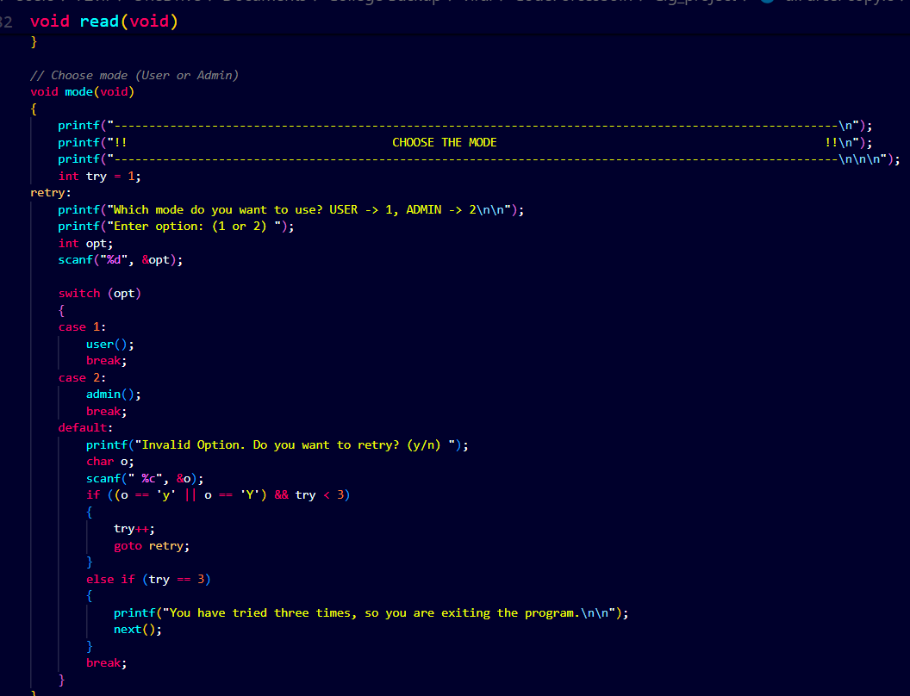
MODE

Slide 8
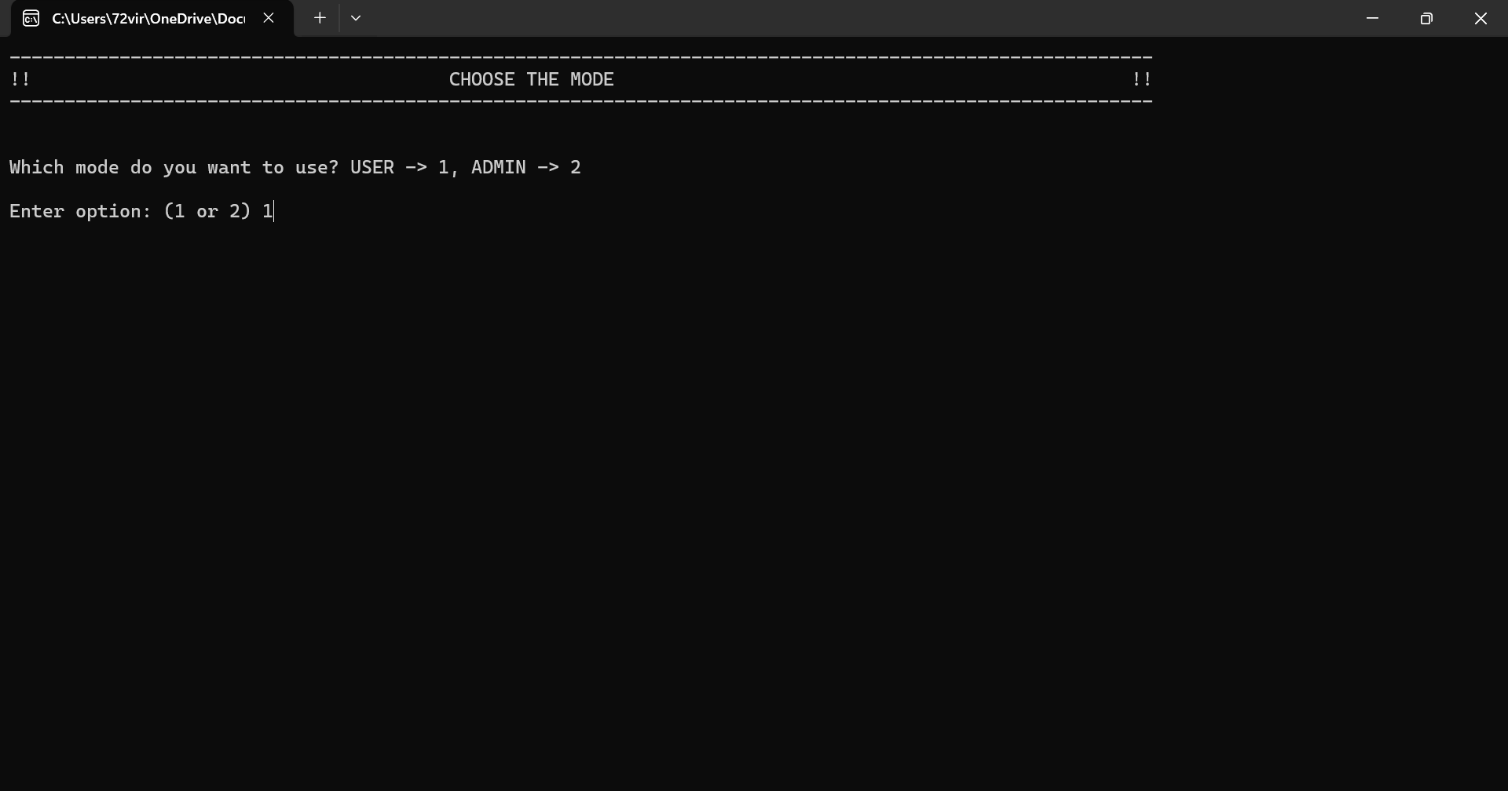
MODE O/P

Slide 9
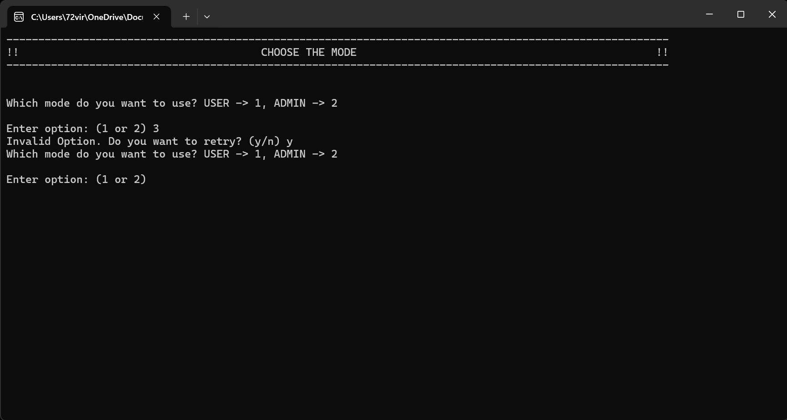
MODE O/P ON ERROR

Slide 10
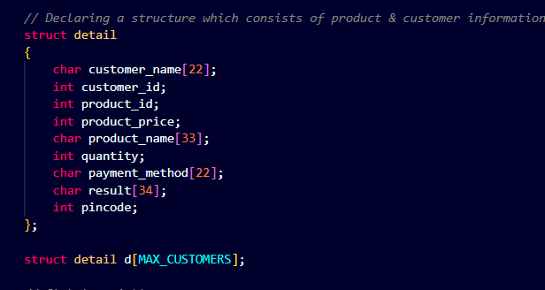
STRUCTURE DETAIL

Slide 11
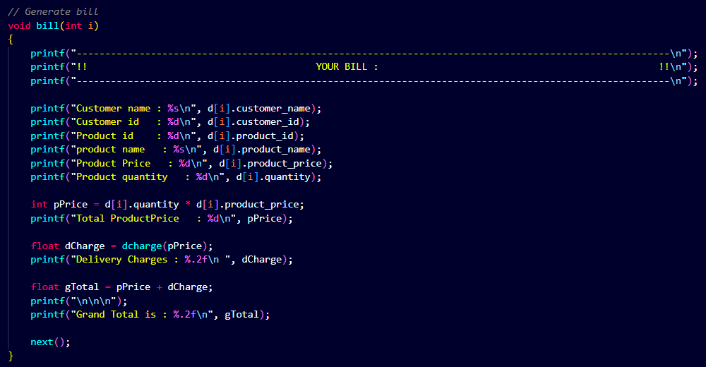
BILL

Slide 12
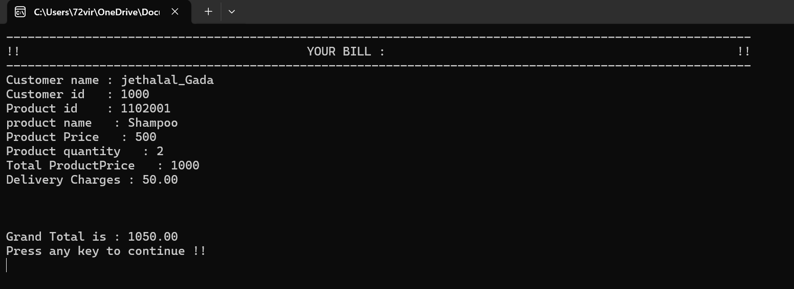
BILL O/P

Slide 13
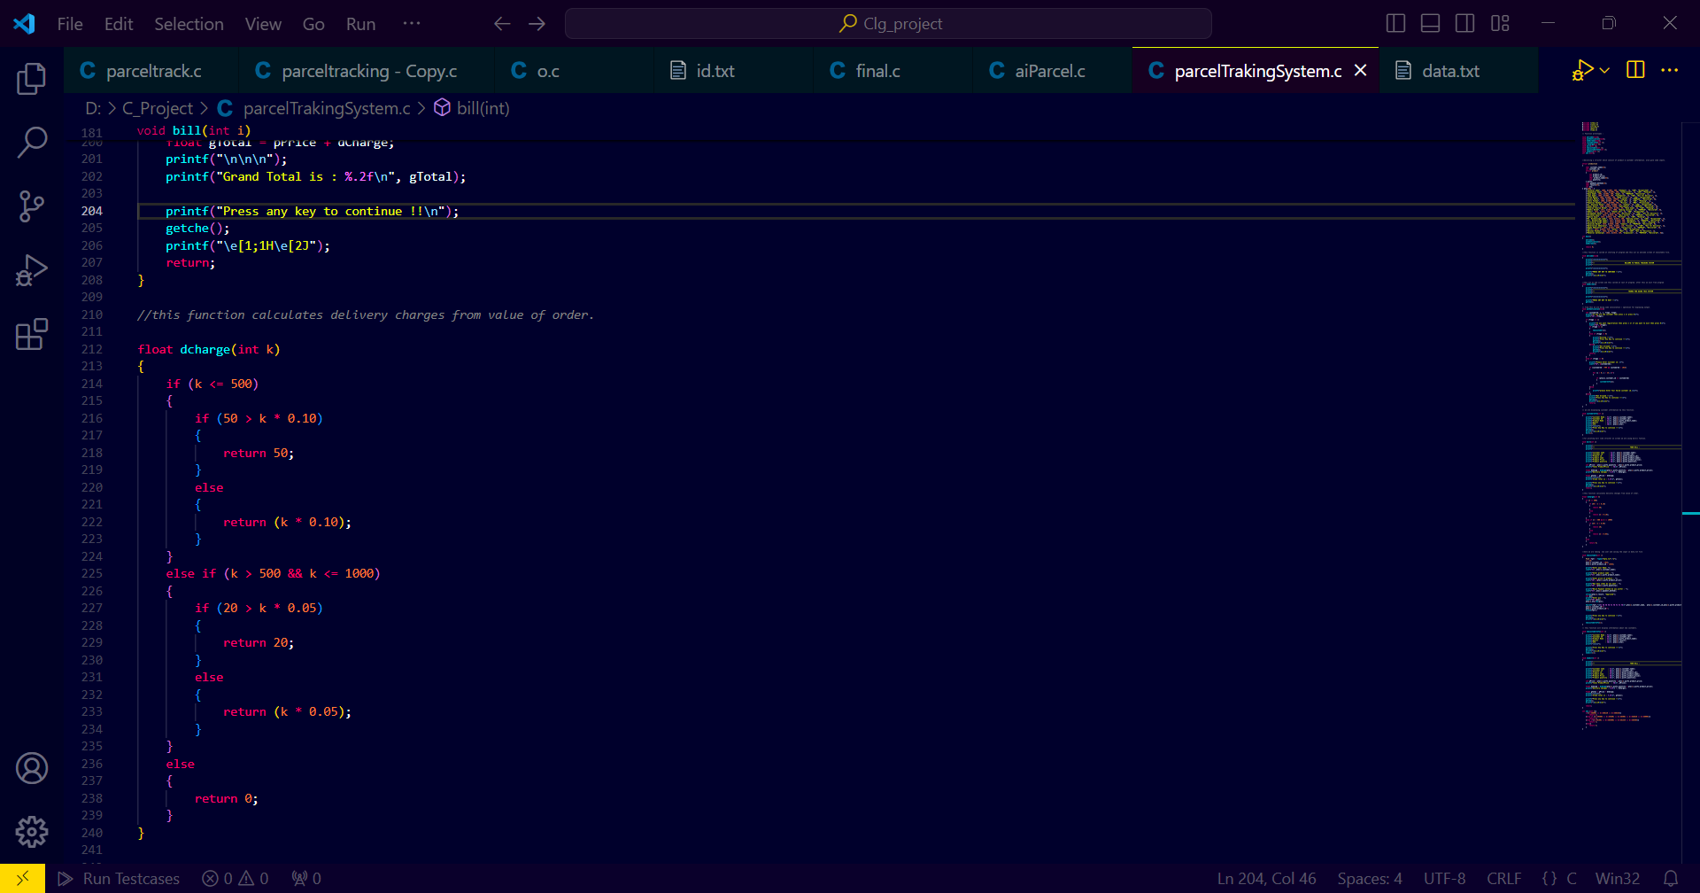
DELIVERY CHARGE

Slide 14
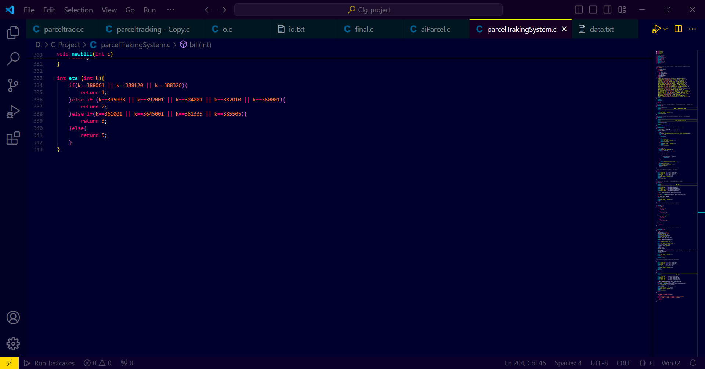
ETA

Slide 15
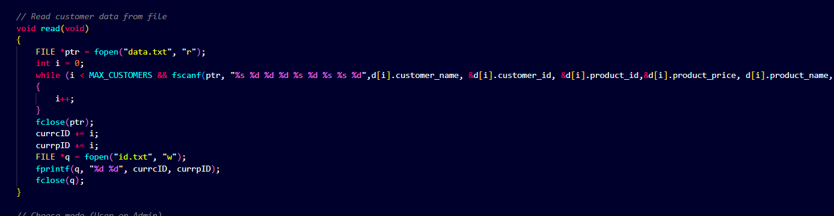
READ FUNCTION

Slide 16
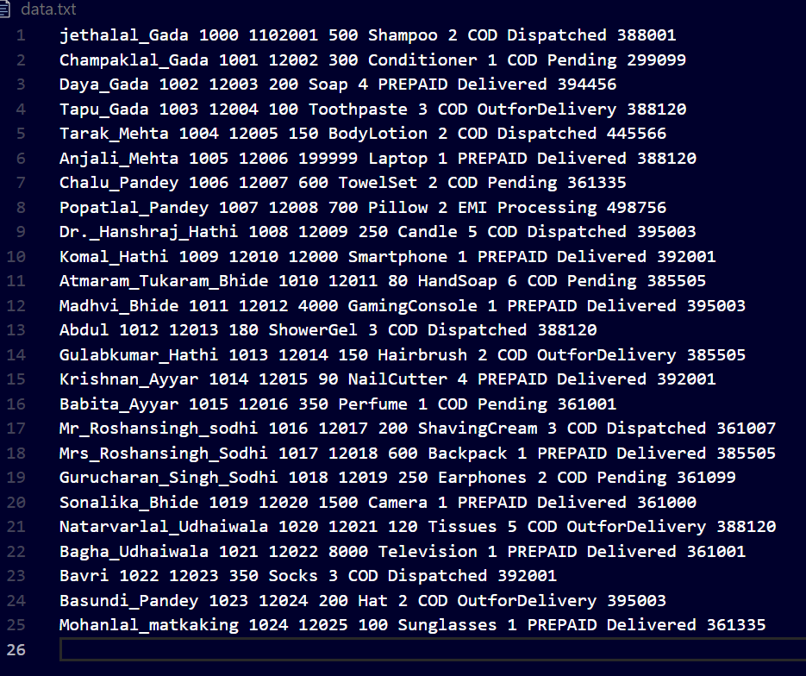
DATA.TXT

Slide 17
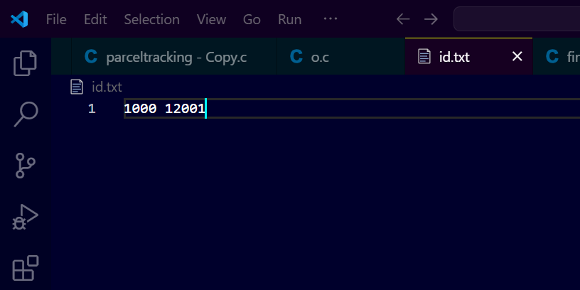
ID.TXT BEFORE READING

Slide 18
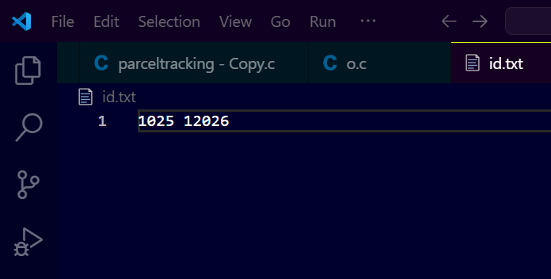
ID.TXT AFTER READING

Slide 19
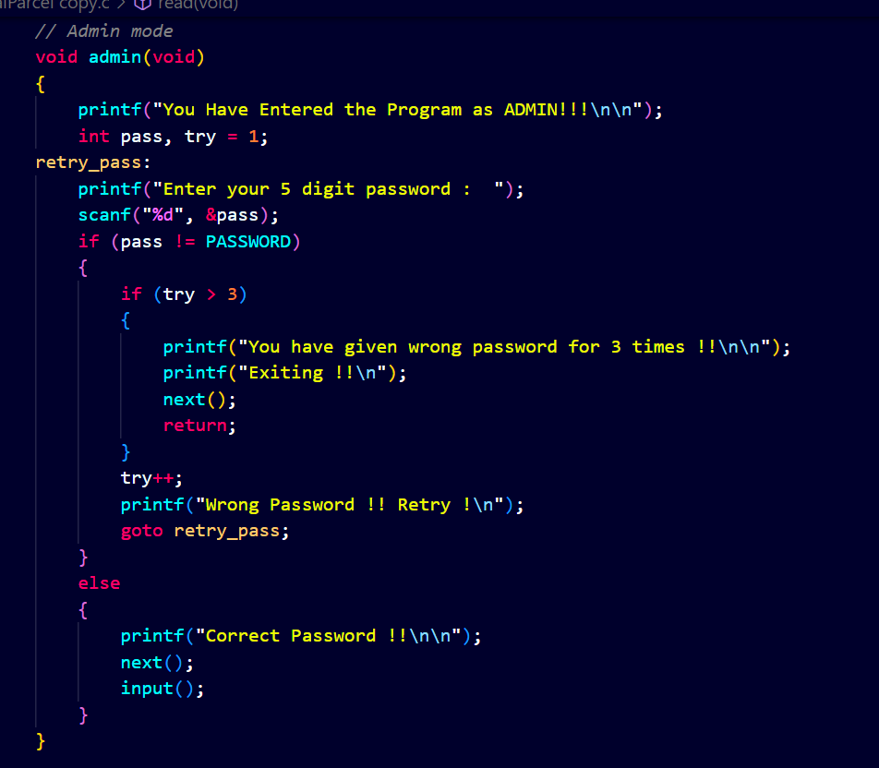
ADMIN

Slide 20
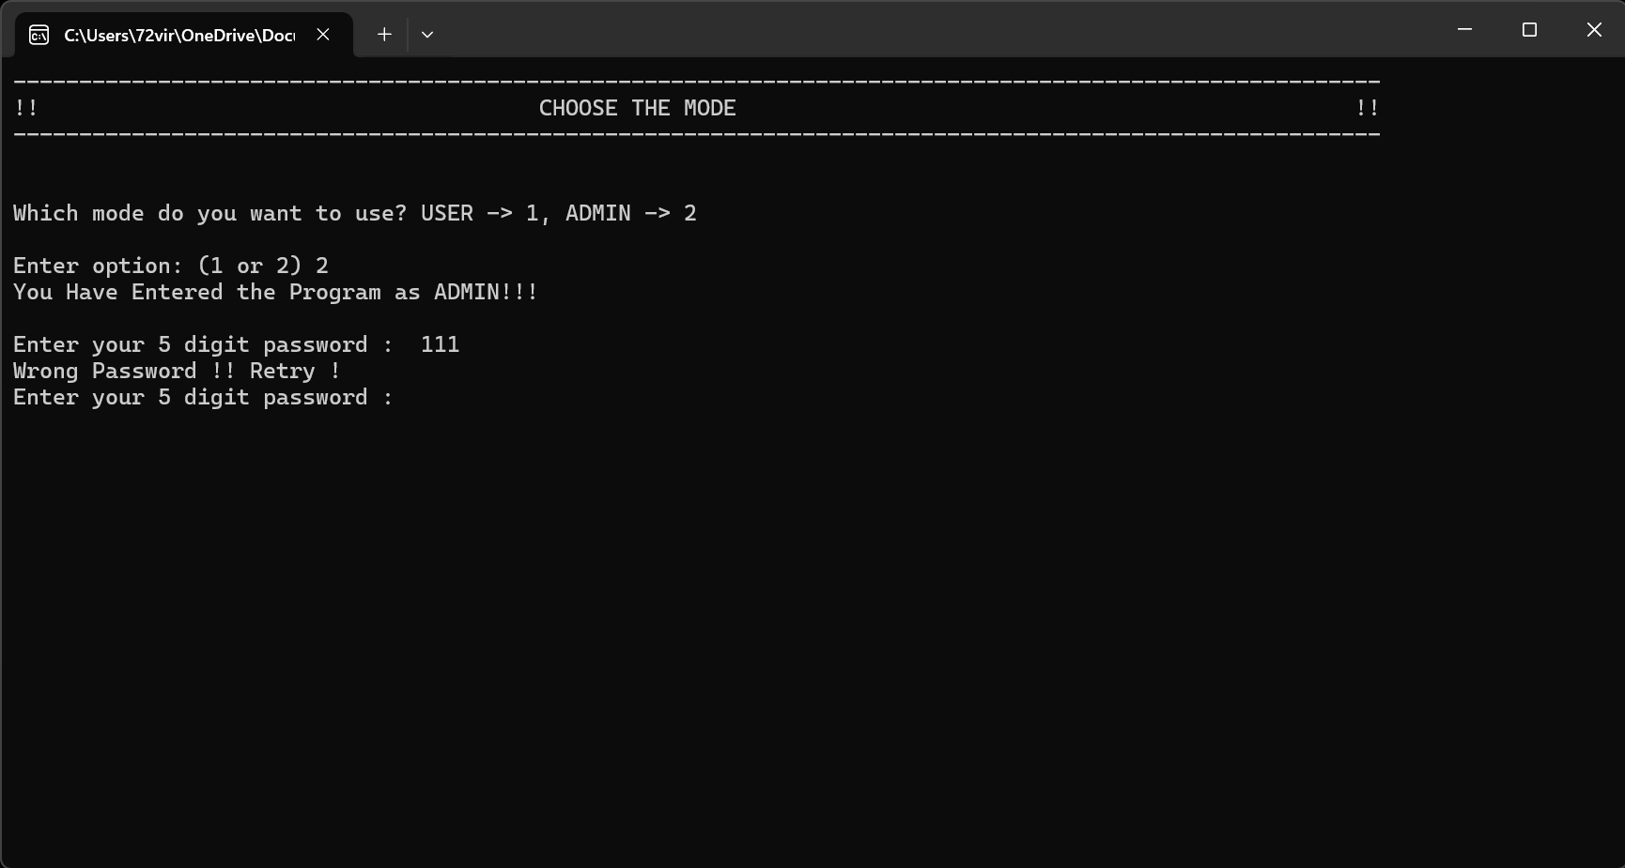
ADMIN

Slide 21
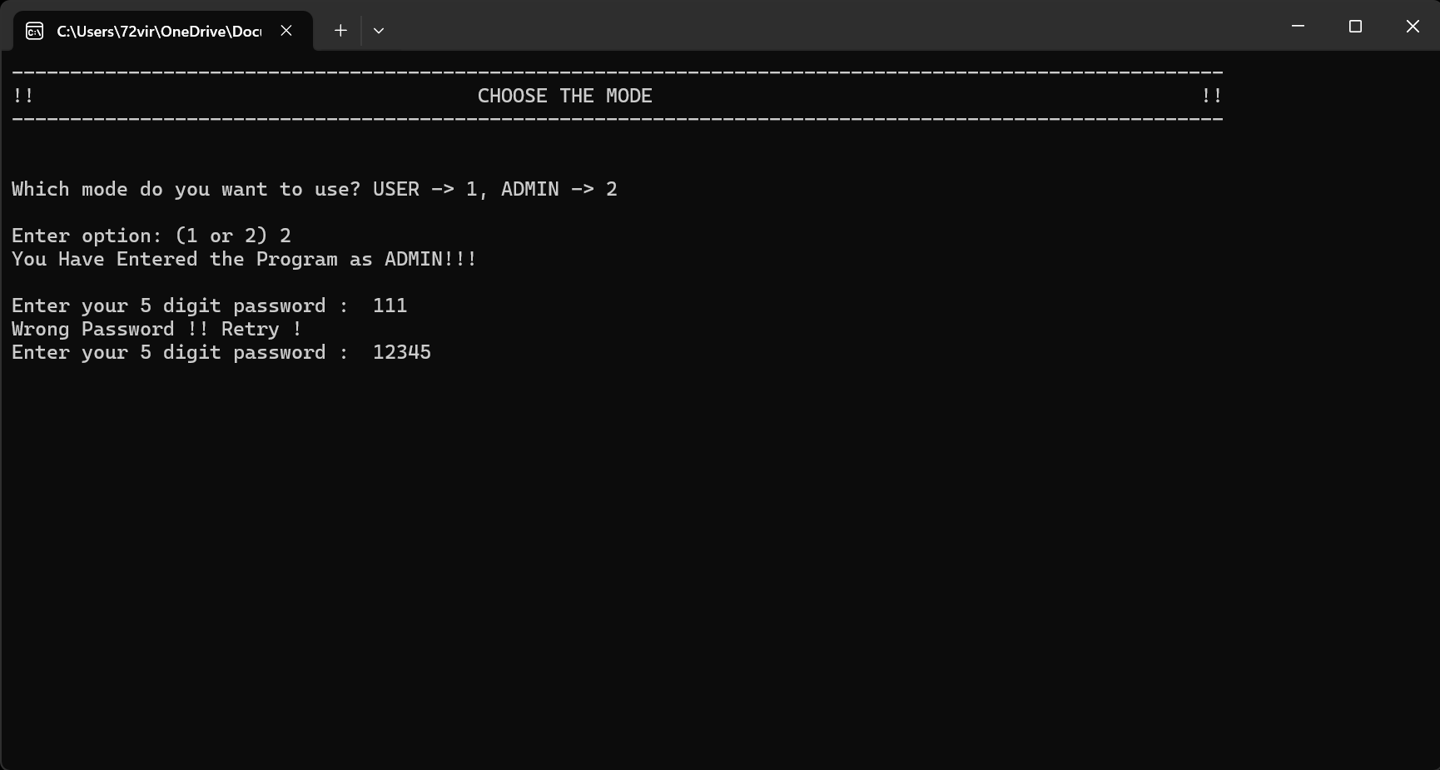
ADMIN

Slide 22
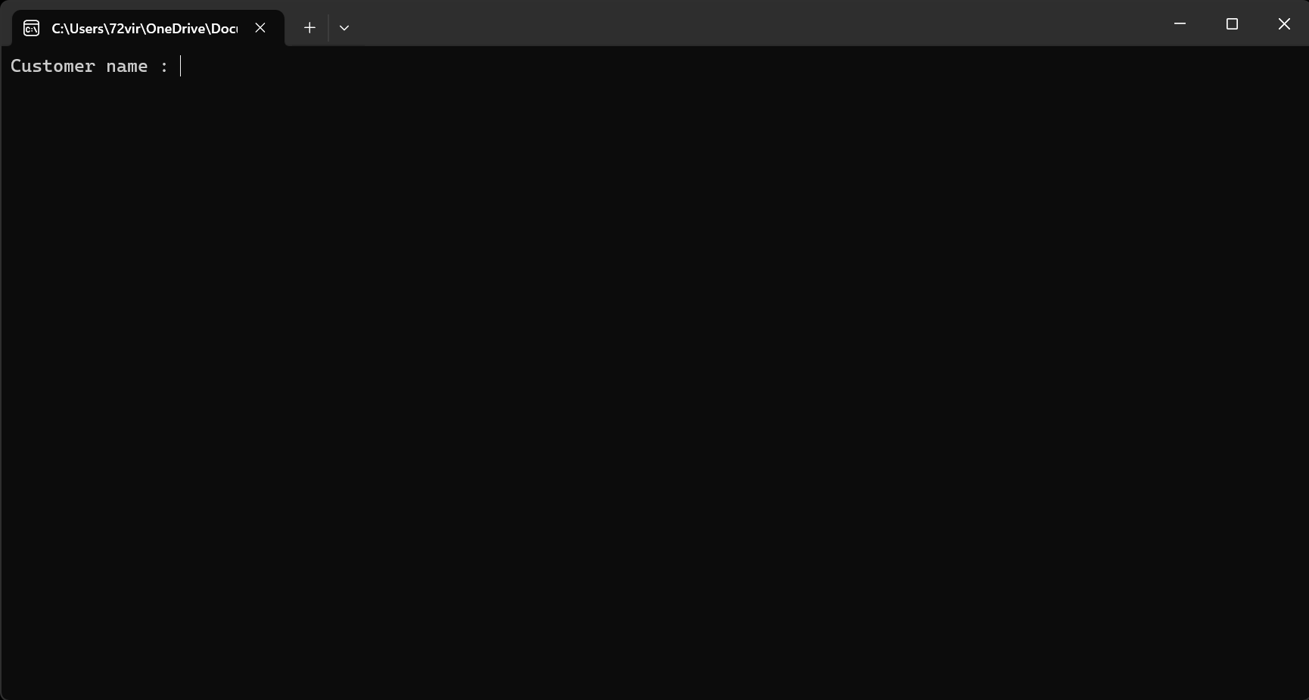
ADMIN

Slide 23
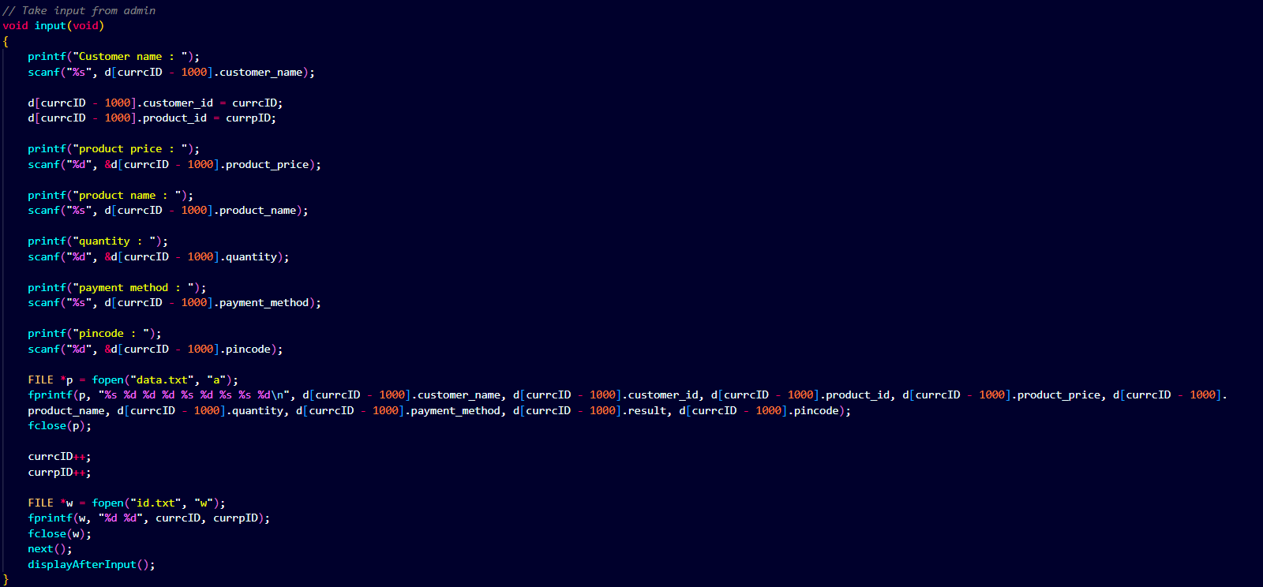
INPUT

Slide 24
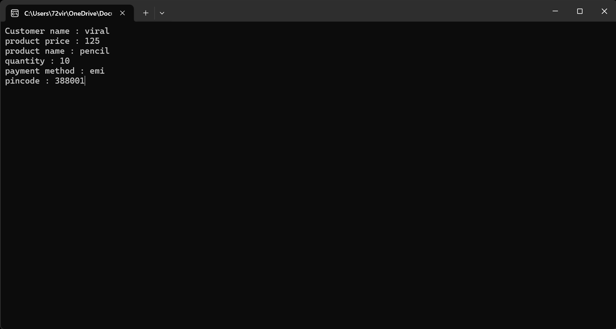
TAKING I/P

Slide 25
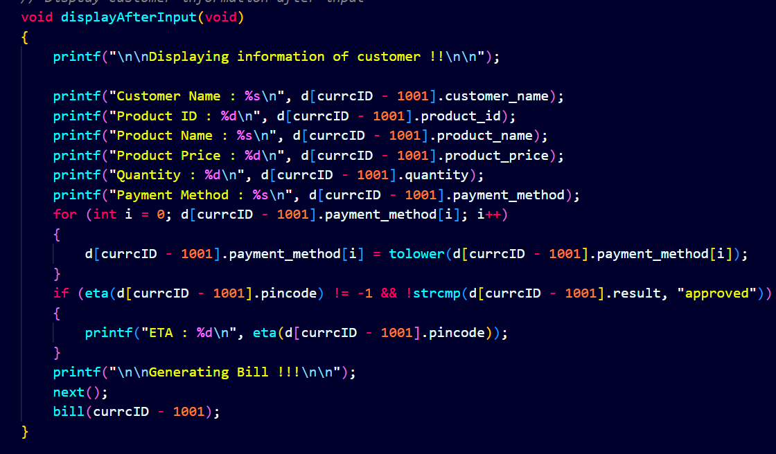
DISPLAYING AFTER INPUT

Slide 26
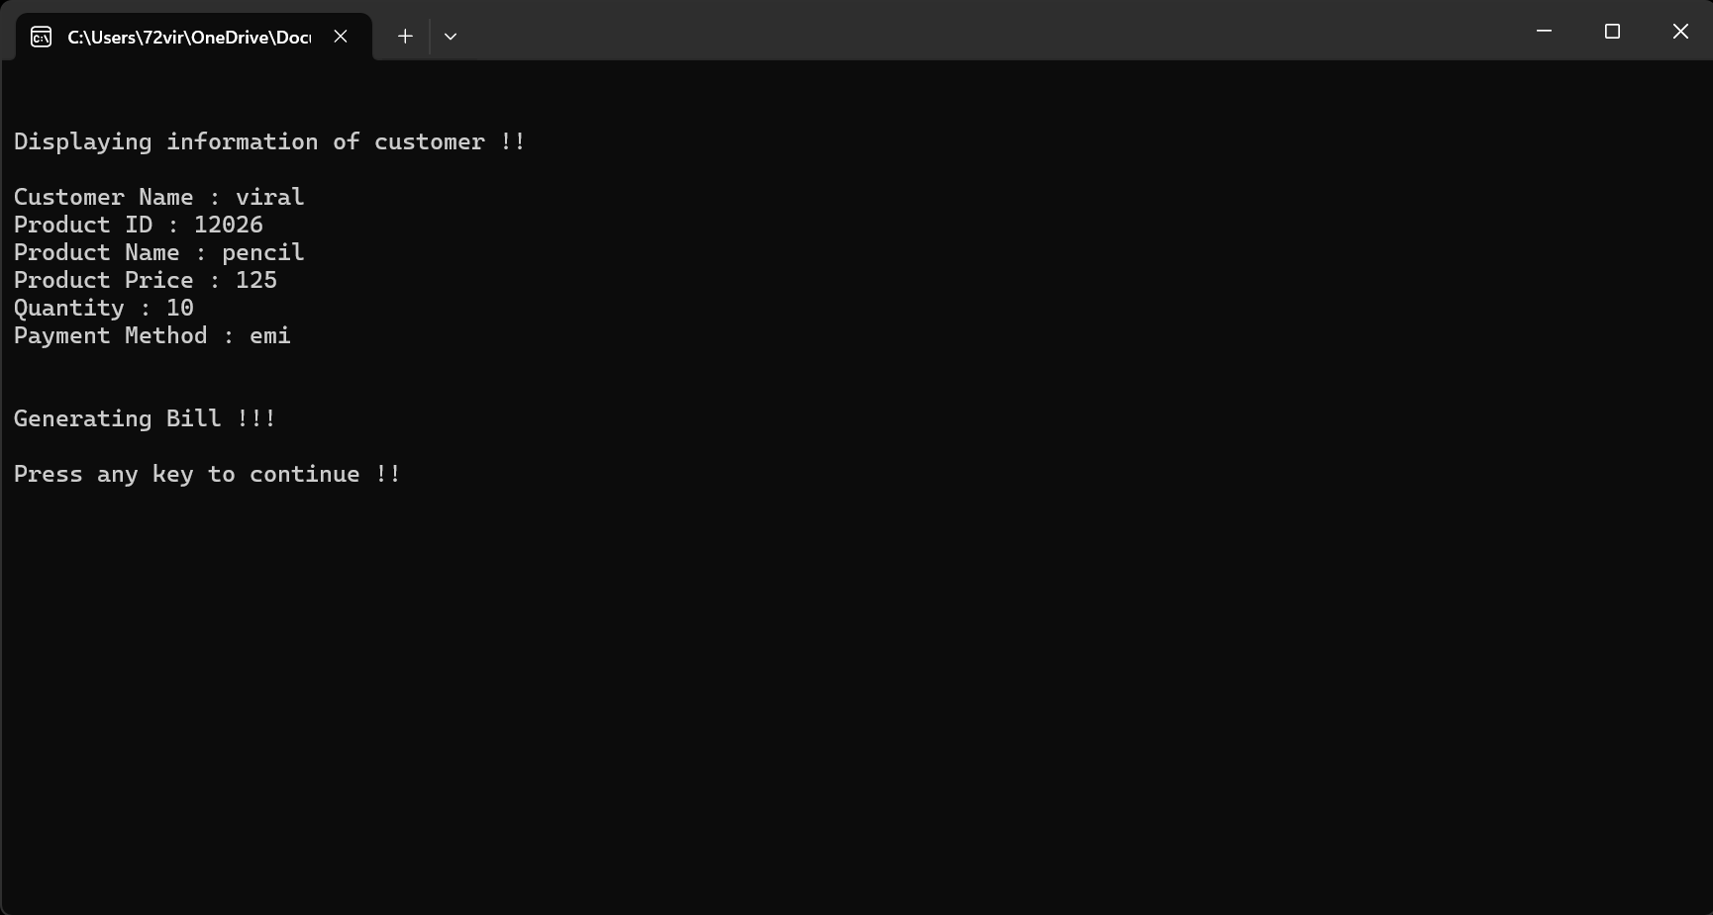
DISPLAYING AFTER INPUT

Slide 27
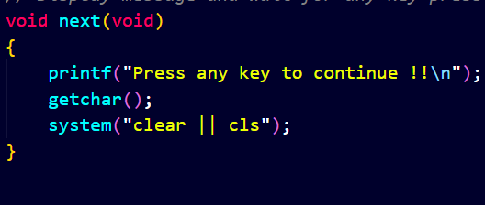
NEXT

